Slide 1
Advance Peripheral Bus (APB) PROTOCOL
By Drashti Khatri

Slide 2
Content
AMBA Architecture
Introduction to APB
Master to Slave Communication
Signal Description
Operation of APB
Write Transfers
Read Transfers
Verilog Code
RTL Schematic
Testbench
Simulation

Slide 3
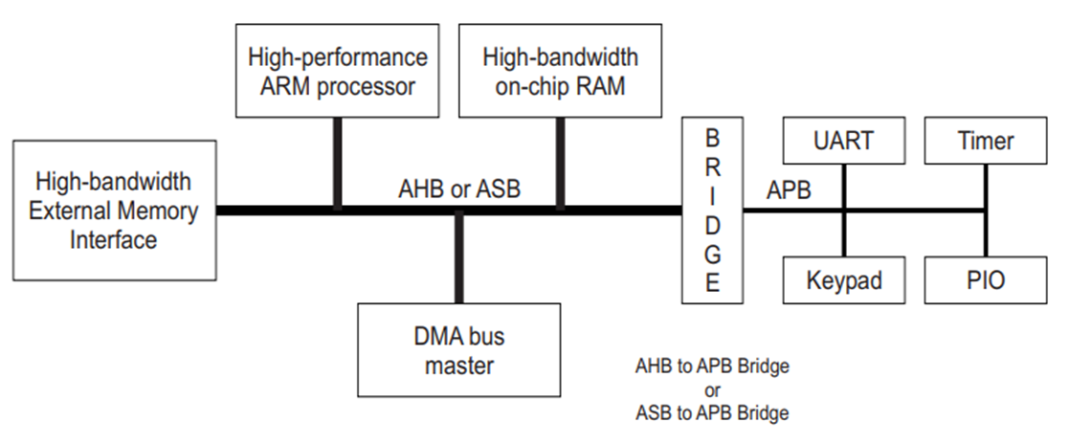
AMBA ARCHITECTURE

Slide 4
Introduction to APB
APB stands for Advanced Peripheral Bus.
APB is a part of AMBA protocol family.
It is a non pipelined protocol.
In APB, every transfer takes at least two cycles (Setup phase and Access phase).
The APB interfaces to any peripherals that are low bandwidth and do not require the high performance of pipelined bus interface.
.The APB can be interfaced with AMBA AHB (Advanced high performance bus), AMBA AXI (Advanced extensible interface).
It is defined as a less priced interface because of its optimization for less consumption of power and less complexity of interface.

Slide 5
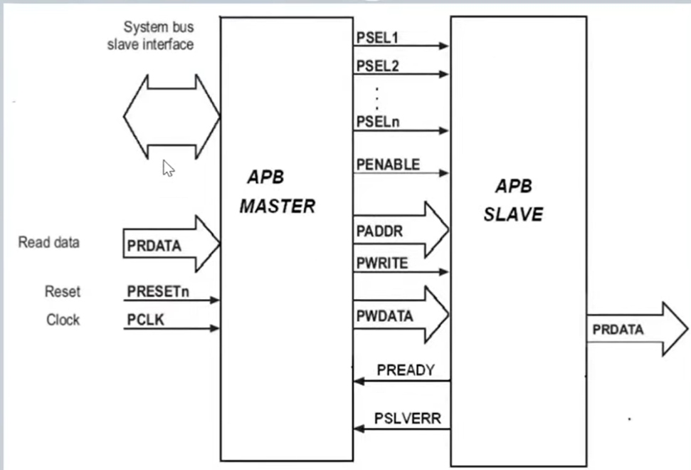
Master to Slave communication

Slide 6
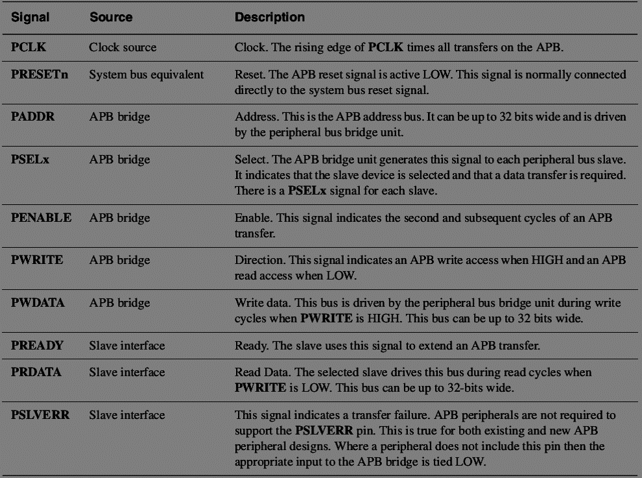
Signal Description

Slide 7
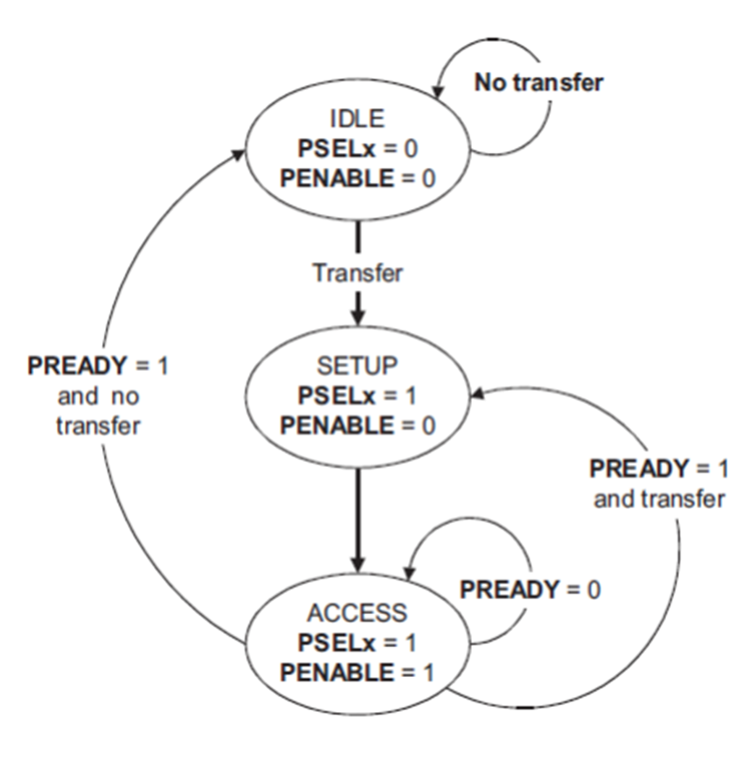
Operation of APB
Idle
Setup
Access

Slide 8
Operating States
Idle : This is the default state of the APB.
Setup : When a transfer is required the bus moves into the SETUP state, where the appropriate
select signal, PSELx, is asserted. The bus only remains in the SETUP state for one clock cycle and always moves to the ACCESS state on the next rising edge of the clock.
Access: The enable signal, PENABLE, is asserted in the ACCESS state. The address,
write, select, and write data signals must remain stable during the transition from
the SETUP to ACCESS state.
Exit from the ACCESS state is controlled by the PREADY signal from the slave:
• If PREADY is held LOW by the slave then the peripheral bus remains in
the ACCESS state.
• If PREADY is driven HIGH by the slave then the ACCESS state is exited
and the bus returns to the IDLE state if no more transfers are required.
Alternatively, the bus moves directly to the SETUP state if another transfer
Follows

Slide 9
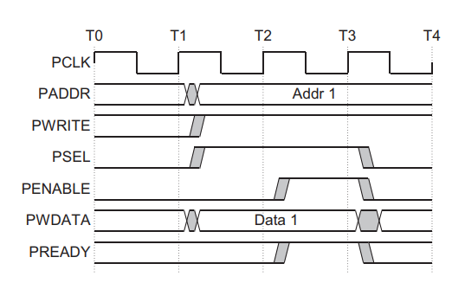
Write Transfers
With no wait states
ACCESS
IDLE
SETUP

Slide 10
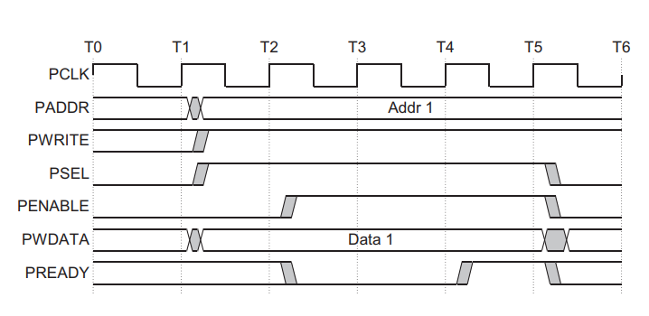
With wait states

Slide 11
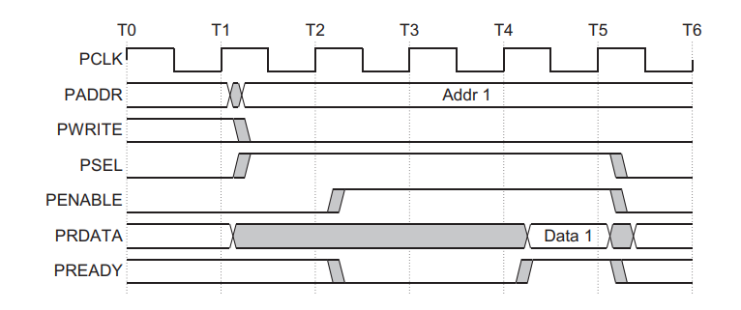
Read Transfer
With wait states
0
1
1
0
0
1
IDLE
SETUP
ACCESS

Slide 12
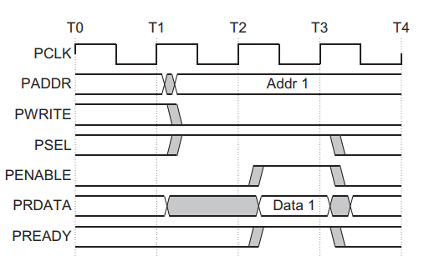
With no wait state

Slide 13
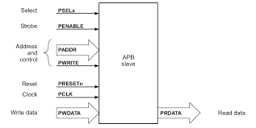
Implementation

Slide 14
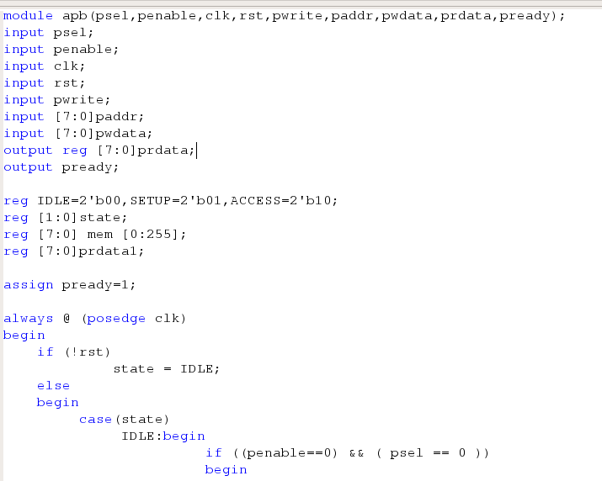

Slide 15
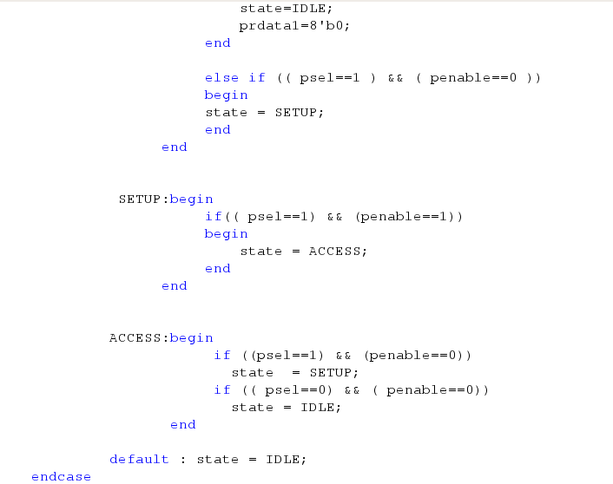

Slide 16
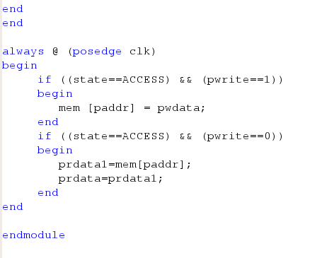

Slide 17
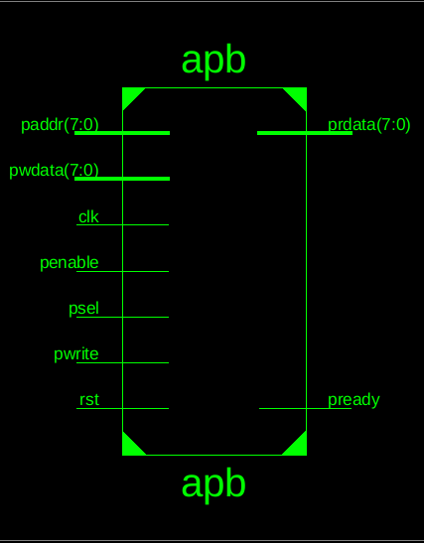
RTL Schematic

Slide 18
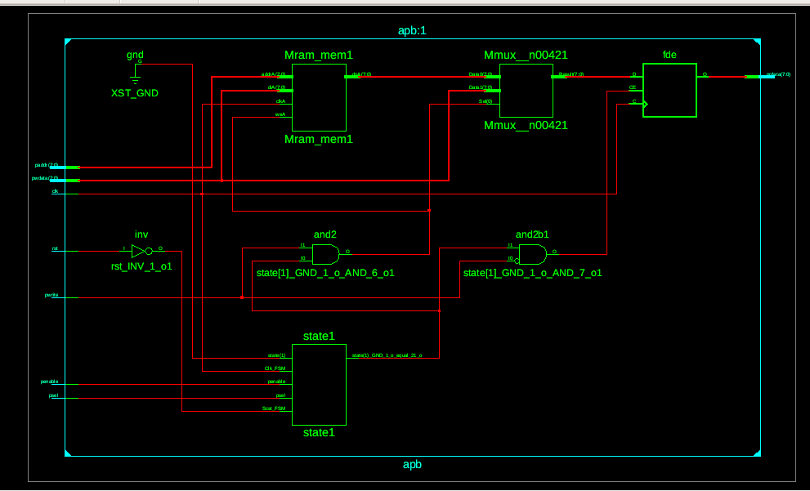

Slide 19
TestBench
module apb_tb;
reg psel, penable, clk, rst, pwrite;
reg [7:0] paddr;
reg [7:0] pwdata;
wire [7:0] prdata;
wire pready;
apb uut (.psel(psel), .penable(penable), .clk(clk), .rst(rst), .pwrite(pwrite), .paddr(paddr), .pwdata(pwdata), .prdata(prdata), .pready(pready));
initial begin
clk=0;
forever #5 clk=~clk;
end
initial begin
psel = 0;
penable = 0;
rst = 0;
pwrite = 0;
paddr = 0;
pwdata = 0;
#10;
psel=1;
penable=0;
rst=1;
pwdata=8'b00001111;
paddr=8'b000000011;
#10;
penable=1;
pwrite=1;
#10;
pwrite=0;
paddr=8'b00000011;
#10;
$monitor ($time, " clk=%b,psel=%b,penable=%b,pwrite=%b,paddr=%b,pwdata=%b,prdata=%b", clk,psel,penable,pwrite,paddr,pwdata,prdata);
#100 $finish;
end
endmodule

Slide 20
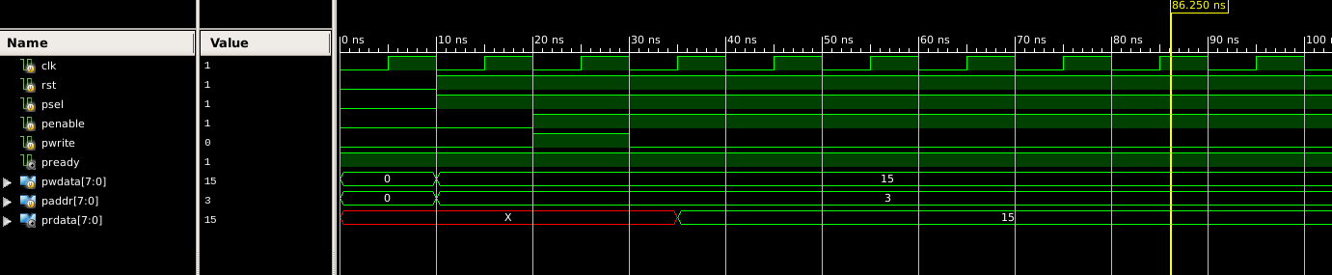
Simulation

Slide 21
Thank You

